Slide 1
Emotion Cause extraction
Using graphs on RECCON dataset to capture the flow of the
conversation
Group 6

Slide 2

1
Task 1: Dataset Preparation
2
Task 2: Annotation
3
Task 3: Model
Contents
4
Results
Topics Covered
5
Demo
6
Contribution
7
Discussions and future work

Slide 3
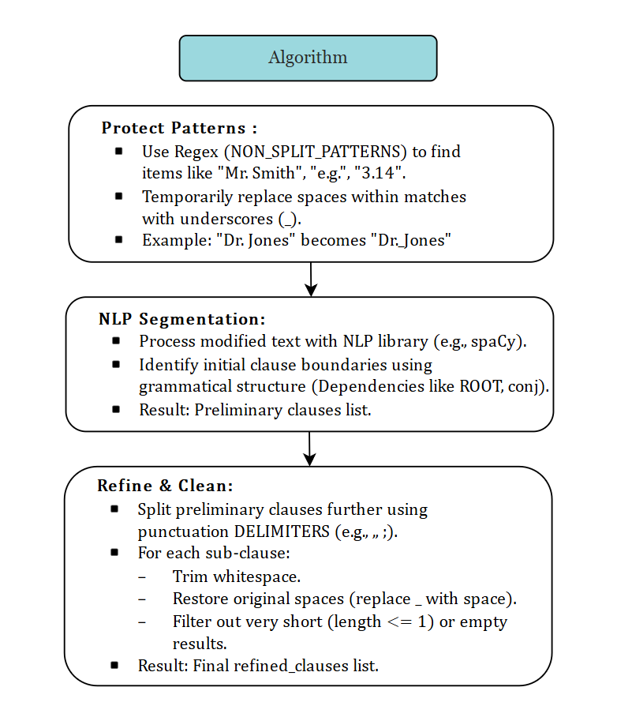
Task 1: Dataset Preparation
Here we prepare the dataset by breaking down a text into distinct grammatical clauses while preserving specific patterns like abbreviations, titles, and numbers.

Slide 4
Utterance: "Hey, you wanna see a movie tomorrow ?"
Clauses: [
"Hey",
"you wanna see",
"a movie tomorrow ?"
]
Utterance: "Sounds like a good plan . What do you want to see ?"
Clauses: [
"Sounds",
"like a good plan",
"What do you want",
"to see ?"
]
Utterance: "How scary can it be ? Come on , it'll be fun ."
Clauses: [
"How scary can it be",
"? Come on",
"it 'll be",
"fun ."
]
Task 1: Dataset Preparation
(output)
Few input/output samples for example

Slide 5
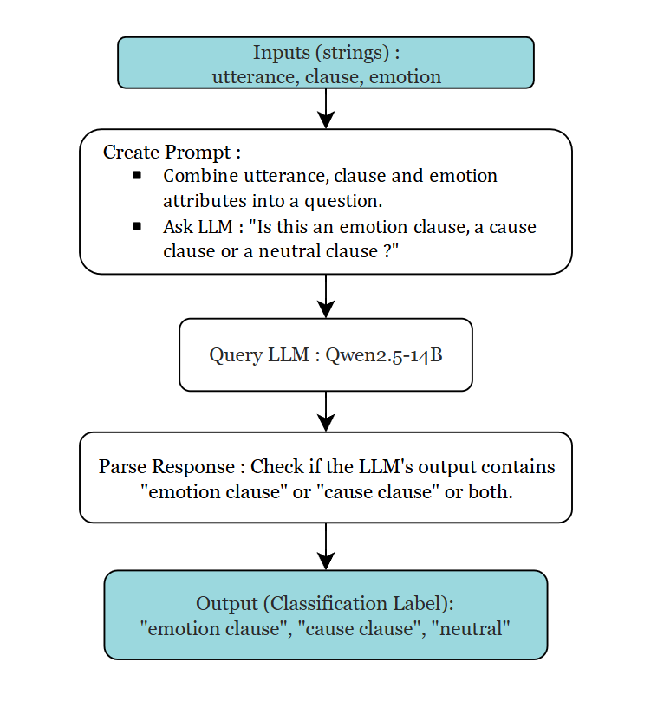
Task 2: Annotation
Here we classify the separated clauses within utterances as expressing emotion or stating the cause of an emotion, using an LLM. The output labels are emotion_clause, cause_clause and neutral.

Slide 6
clause: "Is Stanley still singing",
label: "emotion_clause"
clause: "You look",
label: "cause_clause"
clause: "a great car",
label: "emotion_clause"
clause: "very comfortable and it goes",
label: "emotion_clause"
clause: "What colour is",
label: "neutral"
Task 2: Annotation
(Results)
Here we classify the separated clauses within utterances as expressing emotion or stating the cause of an emotion, using an LLM. The output labels are emotion_clause, cause_clause and neutral.

Slide 7
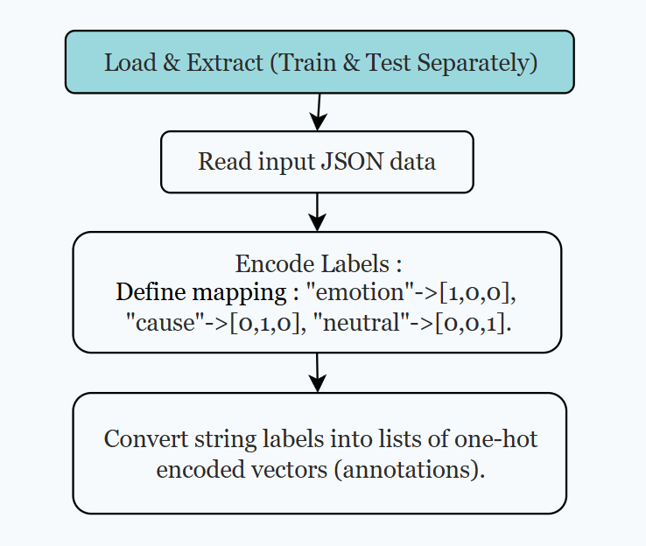
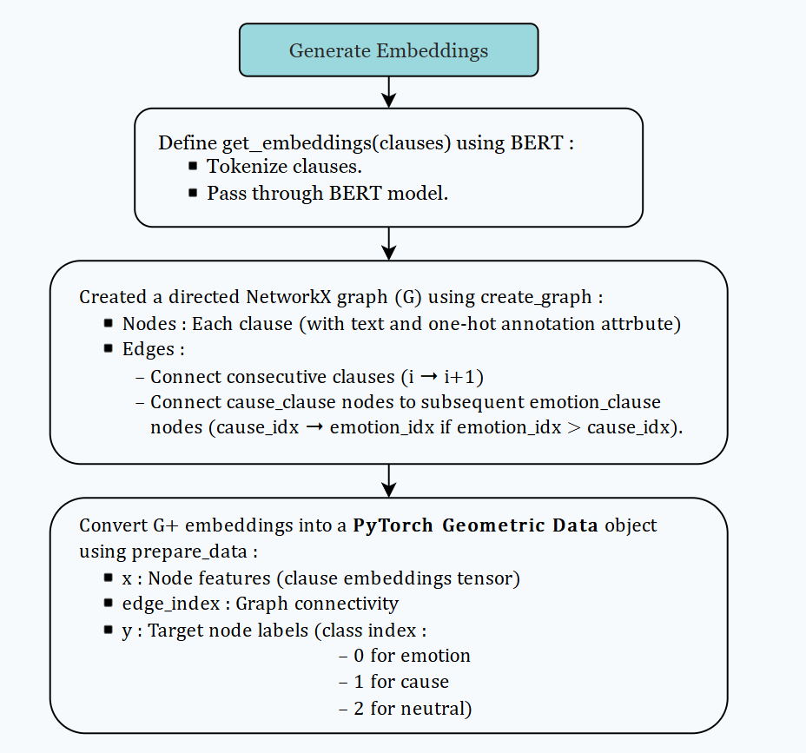
Task 3: Model
This code focuses on building graphs from labeled clauses and using a Graph Neural Network (GNN) for node classification and identifying emotion-cause relationships.

Slide 8
Define GNN Model:
Create GraphTransformer class (using GCNConv layers).
Input dim = Embedding size (768), Output dim = 3 (classes).
Train GNN:
Initialize GraphTransformer model, Adam Optimizer, CrossEntropyLoss Criterion.
Loop for NUM_EPOCHS:
Call train_model:
Batch data_list using Batch.from_data_list.
Forward pass through GNN (model(batch.x, batch.edge_index)).
Calculate loss vs batch.y.
Backpropagate & optimizer step.
(Periodically evaluate node classification accuracy on data_list using evaluate_model and print progress).
Save Trained Model: Store the model's state dictionary.
Evaluate on Test Set:
Call evaluate_model using the trained model and the test_data_list.
Calculate and print the final node classification accuracy on unseen test data.
Task 3: Model (GNN training)
This slide focuses on the GNN training algorithm

Slide 9
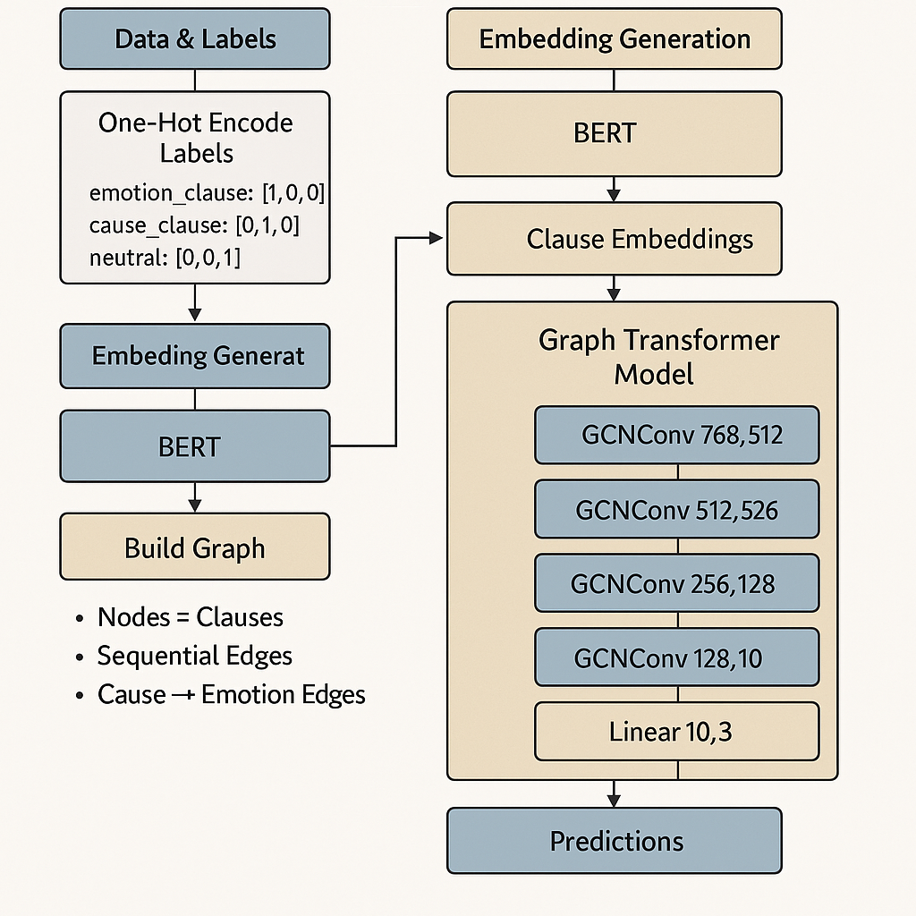
Task 3: Model
High level Idea

Slide 10
Accuracy (Train): 86.74%
Accuracy (Test): 85.52%
Precision:
Macro Average: 0.85
Micro Average: 0.86
Recall:
Macro Average: 0.80
Micro Average: 0.86
F1 Score:
Macro Average: 0.82
Micro Average: 0.85
Class wise metrics:
Emotion Clause:
Precision: 0.86
Recall: 0.82
F1: 0.84
Cause Clause:
Precision: 0.85
Recall: 0.66
F1: 0.74
Neutral Clause:
Precision: 0.85
Recall: 0.92
F1: 0.89
Results
The results and metrics after training the model

Slide 11
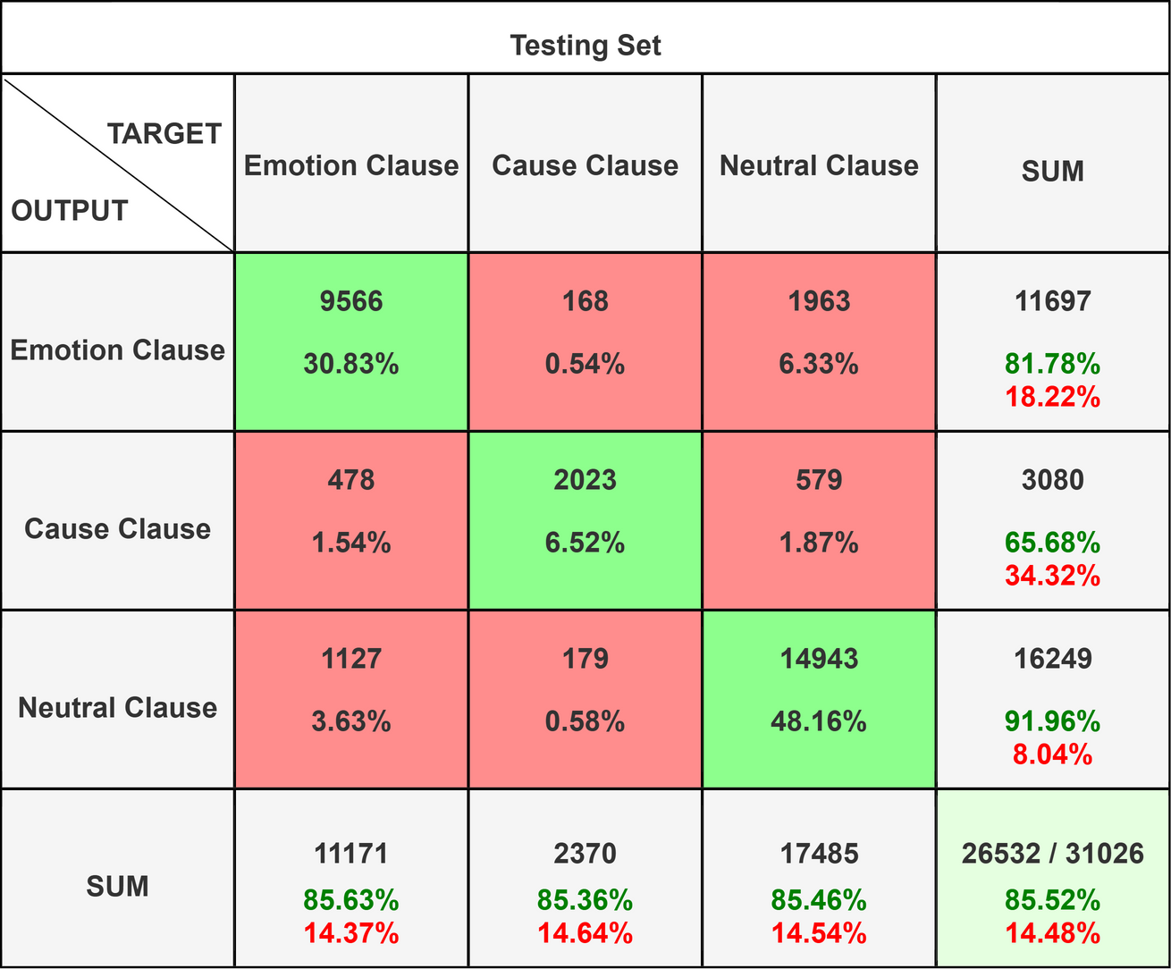
Results
Confusion matrix

Slide 12
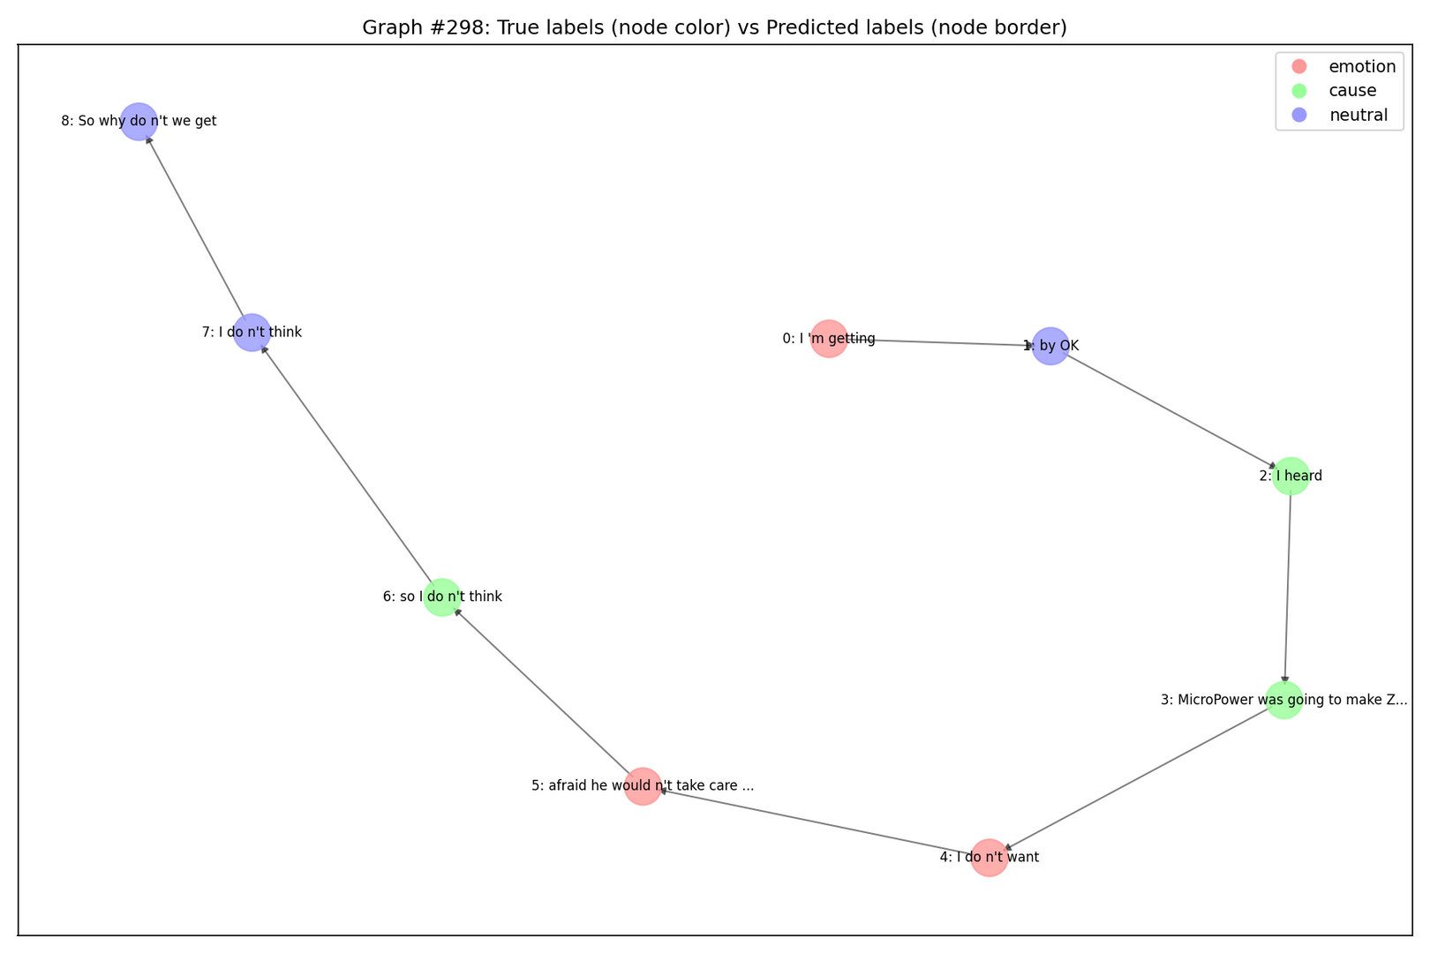
Results
Graph Visualizations

Slide 13
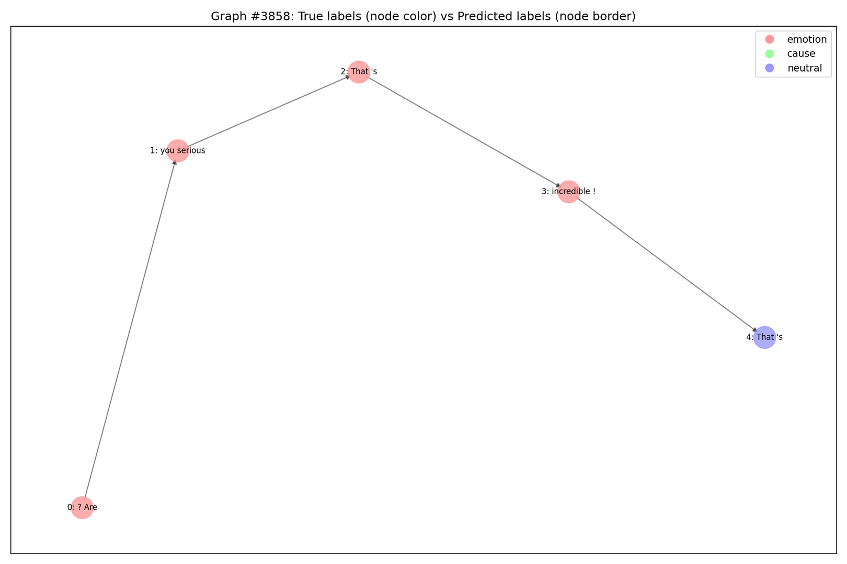
Results
Graph Visualizations

Slide 14
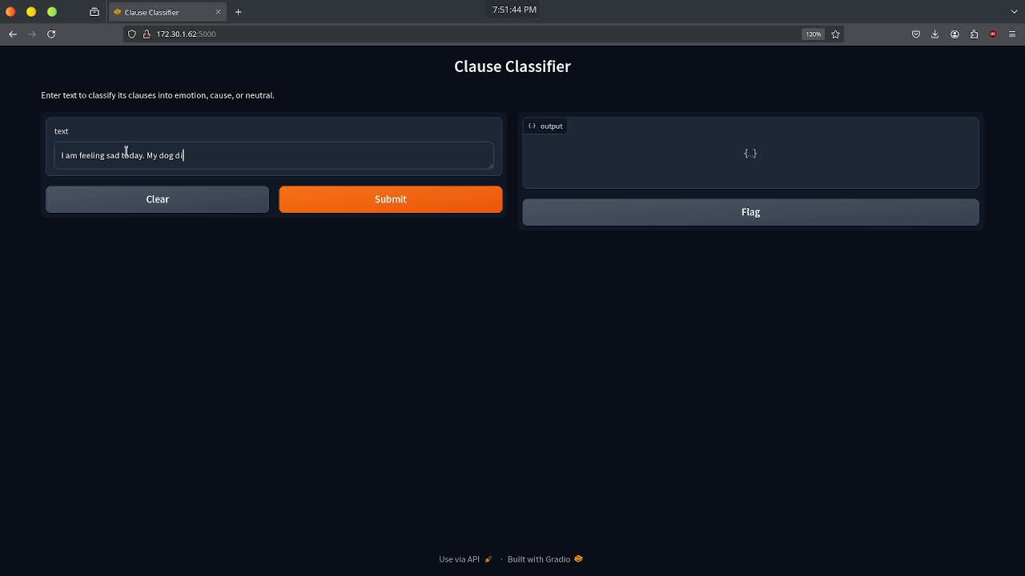
Demo
Demo video showing how it works

Slide 15
Aritra Bhaduri (2101AI40):
Worked on creating proper clause splitting in task 1.
Contributed to task 2 in configuring LLMs and prompt generation.
Created presentation slides and plots.
Asmit Ganguly (2101CS87):
Worked in task 2 in improving classification accuracy.
Created GNN model, training loop and evaluation code
Created demo frontend using gradio.
Prabhat Kumar Malviya (2101CS58)
Contributed to task 2 for automating the annotation process for test and train datasets.
Added Model schematics for the presentation.
Contribution
Work done by individual members

